Slide 1
Ovulation For ART
SIG Endocrinology 2019
Chairperson – Madhuri Patil

Slide 2
Aim Of Ovulation Induction
Induction of follicular growth
Pharmacological agents initiate, augment or modulate the hormonal & gametogenic response of the ovary
Overcome natural follicular selection process to increase the number and quality of oocytes available for fertilization
Time IUI and OR

Slide 3
Before starting ovarian stimulation
Analysis of the ovarian reserve
Define goal of ovarian stimulation
Select the correct stimulation protocol

Slide 4
Select the correct stimulation protocol
Most Individualized protocols based on following parameters of ORT
COS
Amended further for BMI
Age
FSH
AFC
AMH
Objective should be to
Optimize response and outcomes
minimizing the risks

Slide 5
Pre-requisites for OI
OI initiated on Day 2/3 only if
Follicular size is < 10 mm
Absence of ovarian cyst
Endometrial thickness < 6 mm
OI drugs should be started on day 2-3 of the MC as Selection of dominant follicle - early follicular phase

Slide 6
Types Of Ovarian Stimulation For ART
 | Methods | Aim
Natural cycle (unstimulated / spontaneous) | No medication | Single Oocyte
Modified natural | HCG only FSH / HMG and GnRh antagonist add backs | Single Oocyte
Mild or Minimal Stimulation | Low dose FSH / HMG Oral compounds GnRH antagonist | 2 – 7 Oocytes
Conventional standard routine COS | GnRH agonist or Antagonist Conventional FSH / HMG dose | > 8 Oocytes

Slide 7
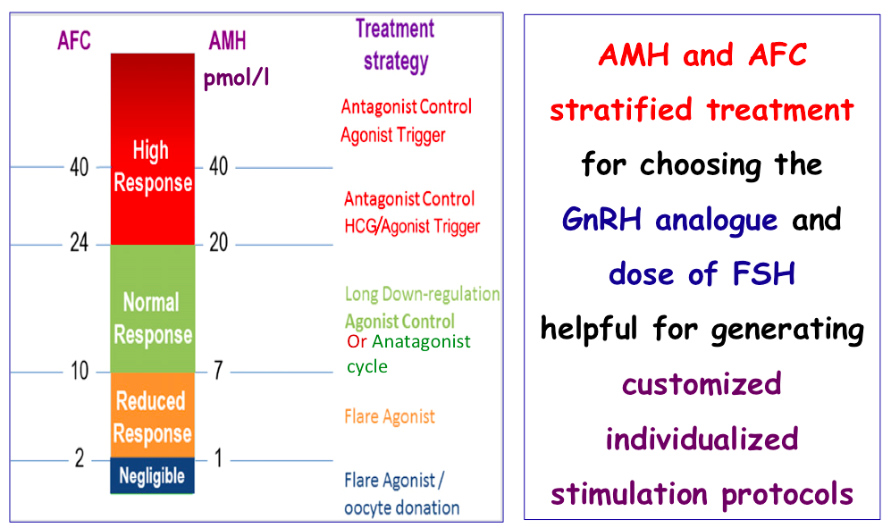
Protocol Choice based on AMH and AFC
Scott M. Nelson, Ph.DFertility and Sterility 2013

Slide 8
Ovarian response depends on:
presence of other infertility factors
genetic: FSH and LH receptor polymorphism
past performance to COS
risk tolerance
FSH-sensitive follicle cohort
type of stimulation regimen used
type of GnRH analogs used
dose of GT

Slide 9
Choosing the GnRH analogues
Non-PCOS
GnRH agonist
Long or short
GnRH antagonist
PCOS
GnRH Antagonist

Slide 10
GnRH Antagonist Protocols
Fixed and Flexible start multiple Dose
Single dose Protocol
Used in all group of patients
Should be used in all PCOS Women

Slide 11
GnRH agonist Protocols
Norma Responders
Results in an uniform cohort
Poor Responders
Can cause premature rise in P4

Slide 12
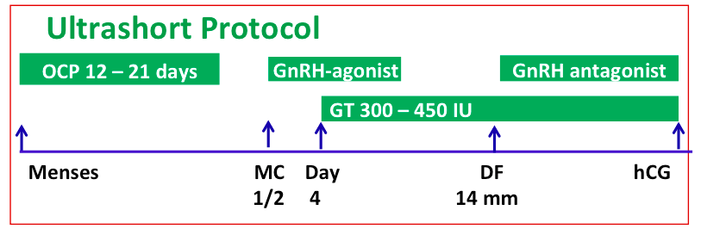
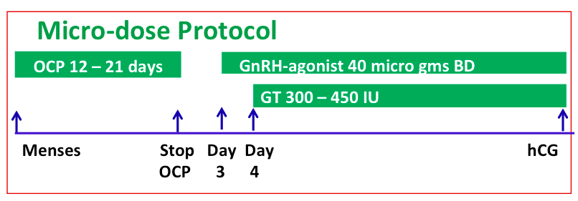
GnRH agonist Protocols
Poor Responders
Poor Responders

Slide 13
Comparison Between Long GnRH agonist and Antagonist Protocols

Slide 14
Advantages of Long GnRH agonist Protocol :
Uniform cohort
More oocytes
Increased pregnancy rate
Suitable for normo responders
Disadvantages of Long GnRH agonist Protocol :
Increased duration of COS
Increased cost
Increased stress – financial / emotional
Increased complication – OHSS
Advantages of Short GnRH agonist Protocol :
Utilizes the initial temporary flare effect for follicular recruitment followed by pitutory desensitization
More suitable for older patients and poor responders
Reduces dose of injection and duration of COS
Disadvantages of Short GnRH agonist Protocol :
Unphysiological LH increased in early phase
Reduced pregnancy rates as compared to long protocol
Advantages of GnRH antagonist Protocol:
Patient friendly – reduced injection and shorter duration of stimulation
Minimal side effects
Reduce risk of complications – OHSS
Disadvantages of GnRH antagonist Protocol
Uniform cohort of follicles may not develop
Increase in dose of GT may be required one antagonist initiated:

Slide 15
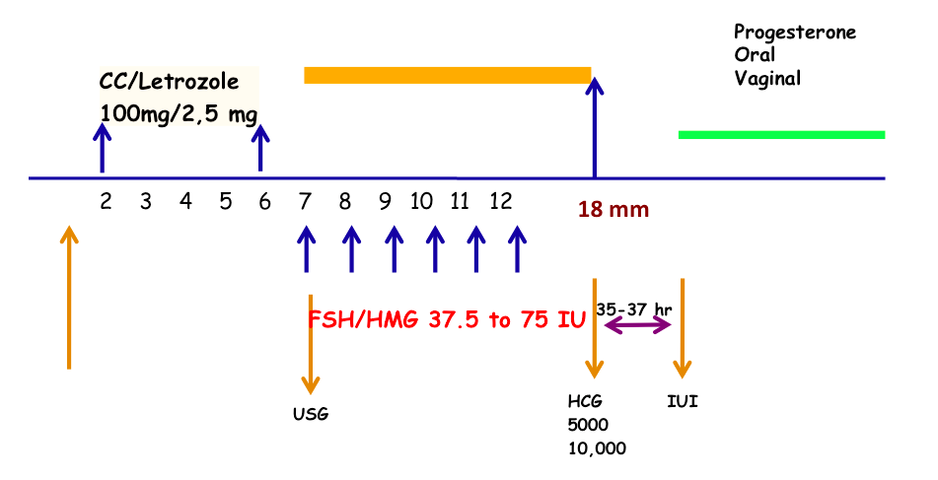
Ovulation Induction Protocols
Oral ovulogens+ GT
CC/Tamoxifen stimulates recruitment of number of small follicles & GTs sustains the growth of recruited follicles

Slide 16
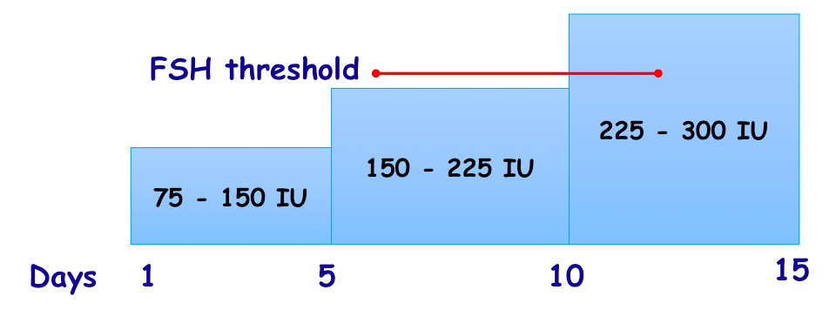
Conventional Step-up protocol
Supraphysiological doses of FSH provoke initial development of a large cohort, stimulate additional follicles, and even rescue those follicles destined to undergo atresia

Slide 17
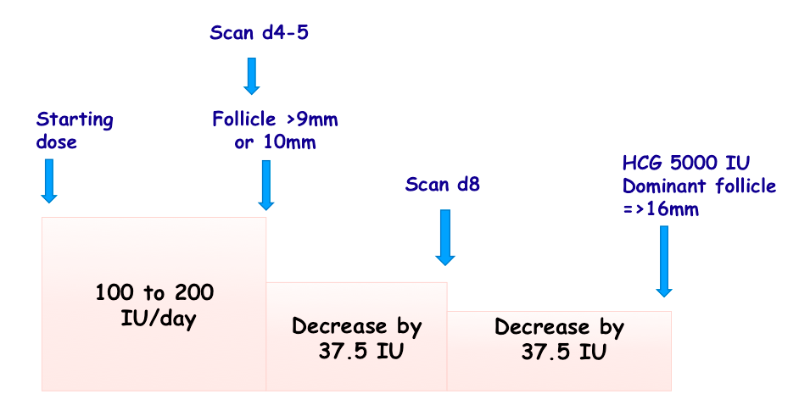
Step -down protocol
Monofollicular development achieved
More physiological
Loading FSH dose (100 – 200 IU/d)
decreased by 37.5IU every 3-5 days

Slide 18
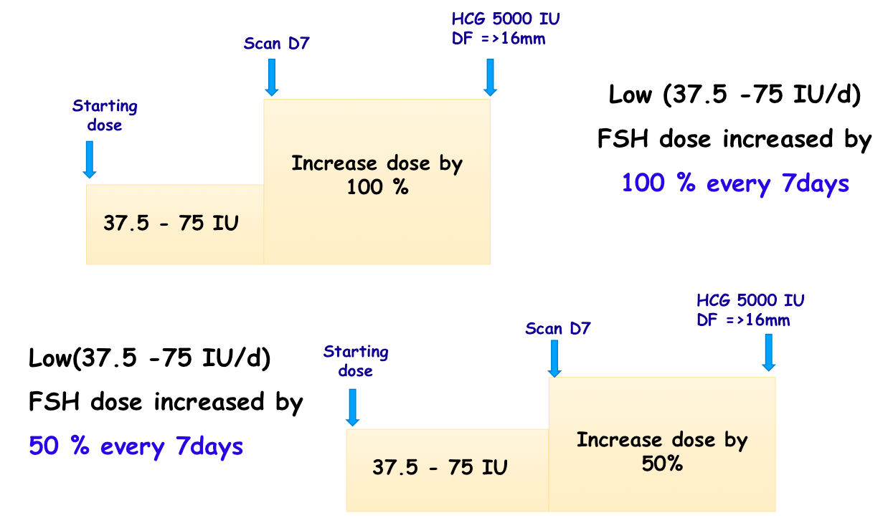
Low dose protocol

Slide 19
Chronic Low dose protocol
Treatment cycles long – 28 –35 Days,
Reduced Multiple folliculogenesis and OHSS
Dose increment to a maximum of 225 IU/day
Once dominant follicle emerges, dose of FSH maintained same until the follicle reaches 18 mm

Slide 20
Step -down protocol
Risk of multi-folliculogenesis and OHSS reduced
FSH threshold dose decreased by 50% when leading follicle 14 mm

Slide 21
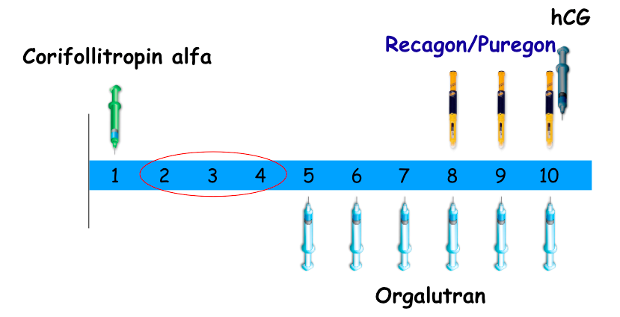
Long acting FSH

Slide 22
Evaluation of Ovarian Reserve Markers
Predict response
To tailor correct stimulation regimen
For adequate response so as to prevent complications
To improve pregnancy outcomes
Improve Efficacy, Safety &
Cost Effectiveness of Treatment

Slide 23
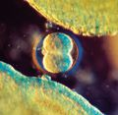
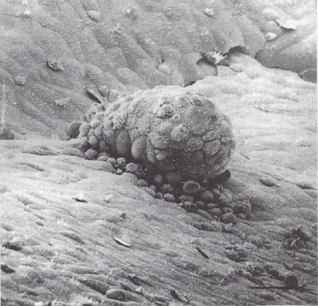
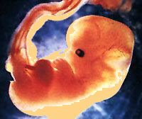
Take home Message -------
Modifying conventional stimulation protocols according to patients’ characteristics and ovarian reserve makes it patient-friendly and optimizes the chance of LBR

